Slide 1
Distributed System
MapReduce
Raft
k/v server
Shared k/v
Maarten van Steen
Andrew S. Tanenbaum
Third edition

Slide 2
Title and Content Layout
Introduction
Architectures
Processes
Communication
Naming
Coordination
Consistency and replication
Fault tolerance
Security
Objectives of learning Introduction to DS
At the end of this course you will be able to:
Define what a distributed system mean.
know why DSs
Know how to develop DS
Know where to apply DSs
Know what are challenging issues
Know types of DSs
Know communication mechanisms of DSs
Know causes of faulty and solution
Know security mechanisms in DSs

Slide 3
Outline
Network protocol
Types of communication
Communication model

Slide 4
Introduction
Interprocess communication is at the heart of all distributed systems
communication in distributed systems is based on message passing as offered by the underlying network as opposed to using shared memory
In a distributed system, processes
run on different machines
exchange information through message passing
Successful distributed systems depend on communication models that hide or simplify message passing
modern distributed systems consist of thousands of processes scattered across an unreliable network such as the Internet
unless the primitive communication facilities of the network are replaced by more advanced ones, development of large scale Distributed Systems becomes extremely difficult

Slide 5
Network Protocols and Standards
a protocol is a set of rules that governs data communications
a protocol defines what is communicated, how it is communicated, and when it is communicated
the key elements of a protocol are syntax, semantics, and timing
syntax: refers to the structure or format of the data
semantics: refers to the meaning of each section of bits
timing: refers to when data should be sent and how fast they can be sent
functions of protocols
each device must perform the same steps the same way so that the data will arrive and reassemble properly;
if one device uses a protocol with different steps, the two devices will not be able to communicate with each other
for instance, for one computer to send a message to another computer, packet

Slide 6
Protocols in a layered architecture
protocols that work together to provide a layer or layers of the model are known as a protocol stack or protocol suite, e.g. TCP/IP
each layer handles a different part of the communications process and has its own protocol
Data Communication Standards
standards are essential for interoperability
data communication standards fall into two categories
De facto standards: that have not been approved by an organized body; mostly set by manufacturers
De jure standards: those legislated by an officially recognized body such as ISO, IEEE

Slide 7
Network (Reference) Models
Layers and Services
within a single machine, each layer uses the services immediately below it and provides services for the layer immediately above it
between machines, layer x on one machine communicates with layer x on another machine
Two important network models or architectures
The ISO OSI (Open Systems Interconnection) Reference Model
The TCP/IP Reference Model
a. The OSI Reference Model
consists of 7 layers
was never fully implemented as a protocol stack, but a good theoretical model
Open – to connect open systems or systems that are open for communication with other systems

Slide 8
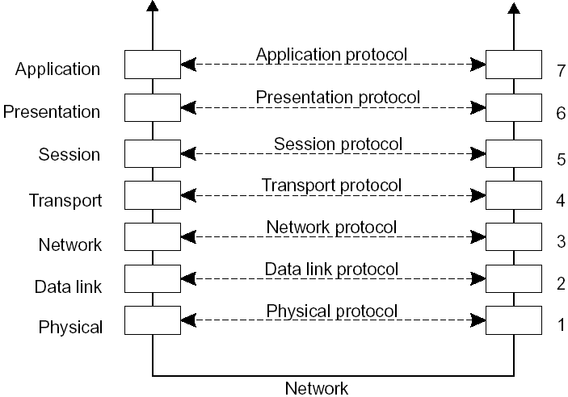
layers, interfaces, and protocols in the OSI model

Slide 9
Media (lower) Layers
Physical: Physical characteristics of the media
Data Link: Reliable data delivery across the link
Network: Managing connections across the network or routing
Transport: End-to-end connection and reliability (handles lost packets); TCP (connection-oriented), UDP (connectionless), etc.
Session: Managing sessions between applications (dialog control and synchronization); rarely supported
Presentation: Data presentation to applications; concerned with the syntax and semantics of the information transmitted
Application: Network services to applications; contains protocols that are commonly needed by users; FTP, HTTP, SMTP, ...
Host (upper) Layers

Slide 10
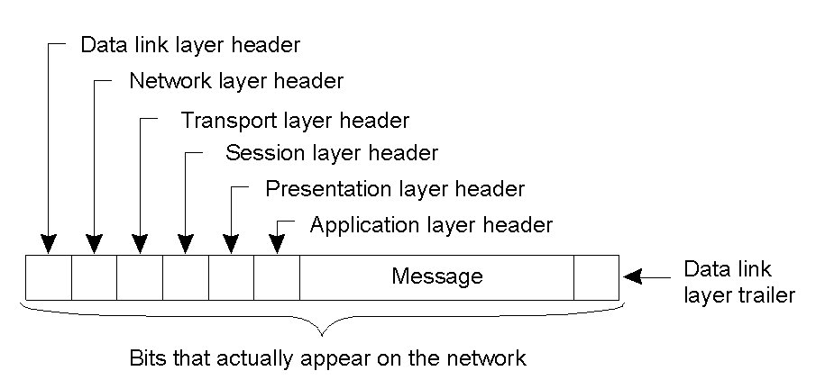
a typical message as it appears on the network

Slide 11
b. The TCP/IP Reference Model
TCP/IP - Transmission Control Protocol/Internet Protocol
used by ARPANET and its successor the Internet
design goals
the ability to connect multiple networks (internetworking) in a seamless way
the network should be able to survive loss of subnet hardware, i.e., the connection must remain intact as long as the source and destination machines are properly functioning
flexible architecture to accommodate requirements of different applications - ranging from transferring files to real-time speech transmission
these requirements led to the choice of a packet-switching network based on a connectionless internetwork layer
has 4 (or 5 depending on how you see it) layers: Application, Transport, Internet (Internetwork), Host-to-network (some split it into Physical and Data Link)

Slide 12
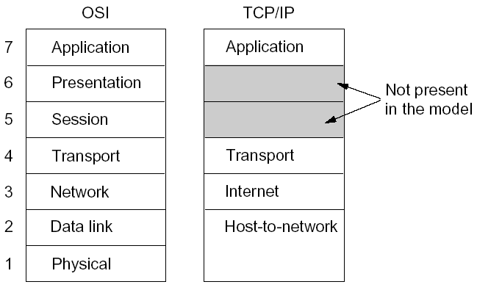
OSI and TCP/IP Layers Correspondence

Slide 13
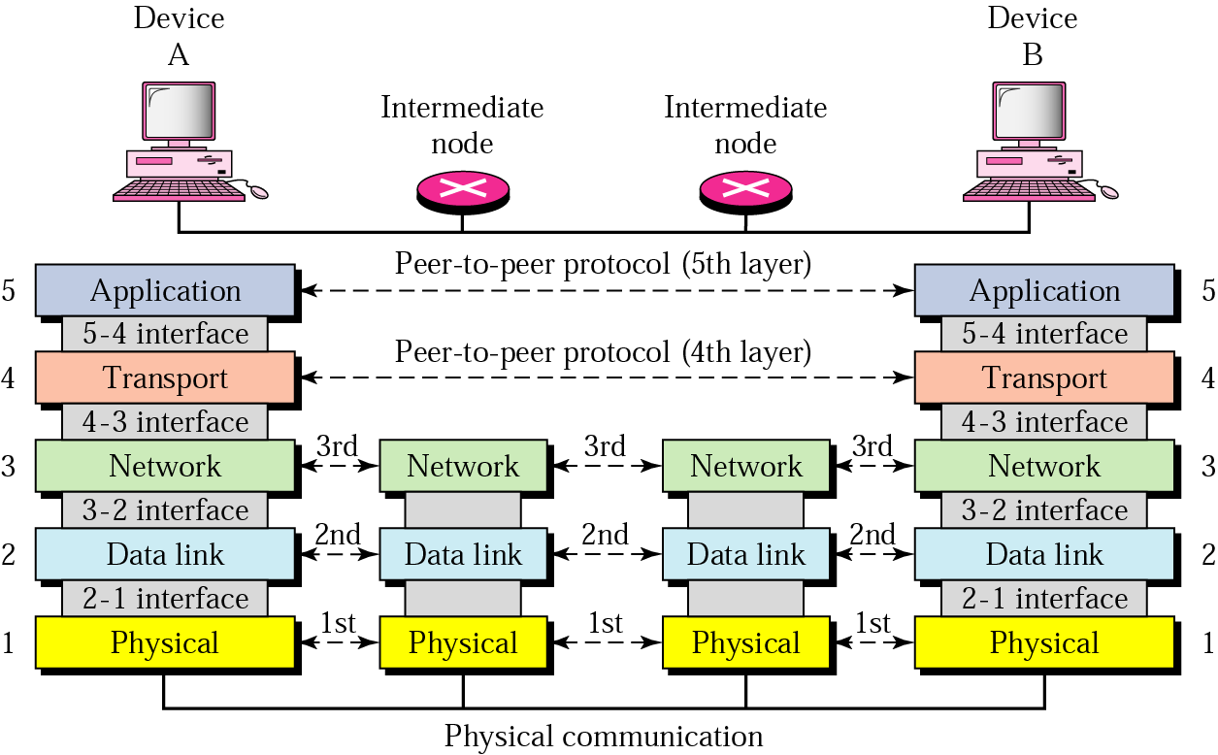
Layers involved in various hosts (TCP/IP)
when a message is sent from device A to device B, it may pass through many intermediate nodes
the intermediate nodes usually involve the first three layers

Slide 14
Middleware Protocols
a middleware is an application that contains general-purpose protocols to provide services
example of middleware services
authentication and authorization services
distributed transactions (commit protocols; locking mechanisms)
middleware communication protocols (calling a procedure or invoking an object remotely, synchronizing streams for real-time data, multicast services)
hence an adapted reference model for networked communications is required

Slide 15
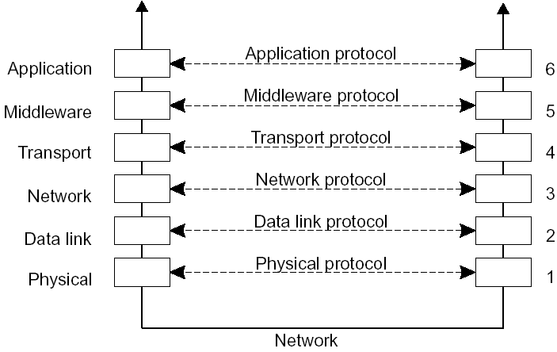
an adapted reference model for networked communication

Slide 16
Types of Communication
Persistent versus transient
Synchronous versus asynchronous
Discrete versus streaming

Slide 17
Persistent versus Transient Communication
Persistent: messages are held by the middleware communication service until they can be delivered (e.g., email)
Sender can terminate after executing send
Receiver will get message next time it runs
Transient: messages exist only while the sender and receiver are running
Communication errors or inactive receiver cause the message to be discarded
Transport-level communication is transient
Notes:
If the router can’t forward the message it will drop it.

Slide 18
Asynchronous v Synchronous Communication
Asynchronous: (non-blocking) sender resumes execution as soon as the message is passed to the communication/middleware software
Synchronous: sender is blocked until
The OS or middleware notifies acceptance of the message, or
The message has been delivered to the receiver, or
The receiver processes it & returns a response

Slide 19
Discrete versus Streaming Communication
Discrete: communicating parties exchange discrete messages
Streaming: one-way communication; a “session” consists of multiple messages from the sender that are related either by send order (TCP streams), temporal proximity (multimedia streams), etc.

Slide 20
Communication Model
introduce the four widely used middleware communication models for distributed systems:
Remote Procedure Call (RPC)
Message-Oriented Middleware (MOM)
Stream-Oriented Communication
Multicast Communication

Slide 21
Remote Procedure Call
the first distributed systems were based on explicit message exchange between processes through the use of explicit send and receive procedures; but do not allow access transparency
in 1984, Birrel and Nelson introduced a different way of handling communication: RPC
it allows a program to call a procedure located on another machine
simple and elegant, but there are implementation problems
the calling and called procedures run in different address spaces
parameters and results have to be exchanged; what if the machines are not identical?
what happens if both machines crash?

Slide 22
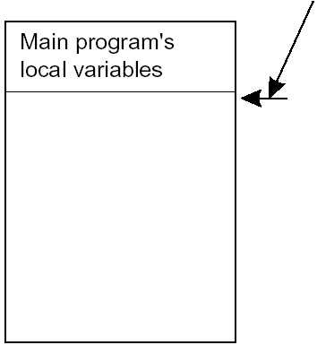
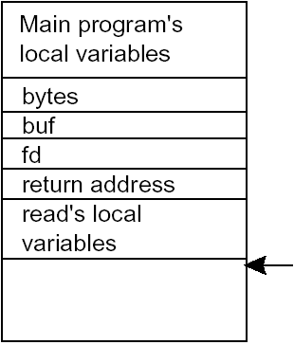
Conventional Procedure Call, i.e., on a single machine
e.g. count = read (fd, buf, bytes); a C like statement, where
fd is an integer indicating a file
buf is an array of characters into which data are read
bytes is the number of bytes to be read
Stack pointer
Stack pointer
parameter passing in a local procedure call: the stack before the call to read
the stack while the called procedure is active
parameters can be call-by-value (fd and bytes) or call-by reference (buf) or in some languages call-by-copy/restore

Slide 23
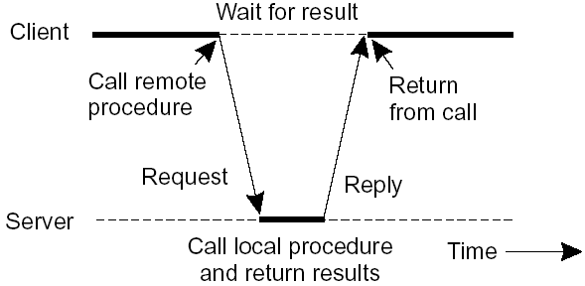
Client and Server Stubs
RPC would like to make a remote procedure call look the same as a local one; it should be transparent, i.e., the calling procedure should not know that the called procedure is executing on a different machine or vice versa
when a program is compiled, it uses different versions of library functions called client stubs
a server stub is the server-side equivalent of a client stub
principle of RPC between a client and server program

Slide 24
Steps of a Remote Procedure Call
Client procedure calls client stub in the normal way
Client stub builds a message and calls the local OS (packing parameters into a message is called parameter marshaling)
Client's OS sends the message to the remote OS
Remote OS gives the message to the server stub
Server stub unpacks the parameters and calls the server
Server does the work and returns the result to the stub
Server stub packs it in a message and calls the local OS
Server's OS sends the message to the client's OS
Client's OS gives the message to the client stub
Stub unpacks the result and returns to client
hence, for the client remote services are accessed by making ordinary (local) procedure calls; not by calling send and receive
server machine vs server process; client machine vs client process

Slide 25
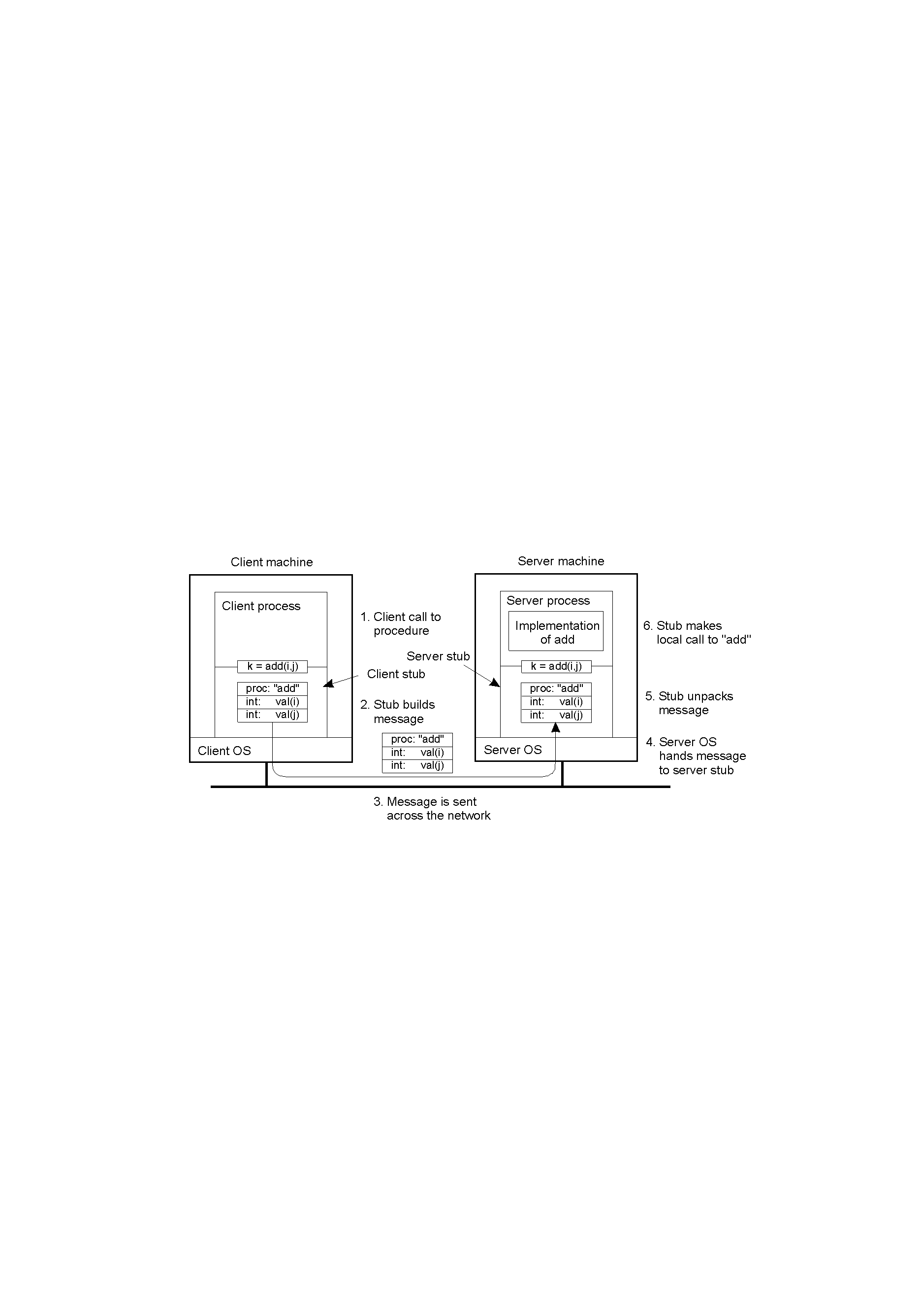
Parameter Passing
1. Passing Value Parameters
e.g., consider a remote procedure add(i, j), where i and j are integer parameters
steps involved in doing remote computation through RPC

Slide 26
the above discussion applies if the server and the client machines are identical
but that is not the case in large distributed systems
the machines may differ in data representation (e.g., IBM mainframes use EBCDIC whereas IBM PCs use ASCII)
there are also differences in representing integers(1’s complement or 2’s complement) and floating-point numbers
byte numbering may be different (from right to left in Pentium called little endian and left to right in SPARC, big endian)
e.g.
consider a procedure with two parameters, an integer and a four-character string; each one 32-bit word (5, “JILL”)
the sender is Intel and the receiver is SPARC

Slide 27
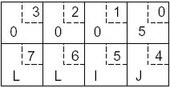
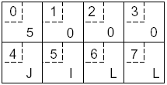
original message on the Pentium
(the numbers in boxes indicate the address of each byte)
the message after receipt on the SPARC; wrong integer (2²⁴+2²⁶ = 83,886,080), but correct string

Slide 28
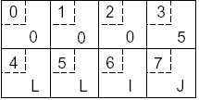
one approach is to invert the bytes of each word after receipt
the message after being inverted (correct integer but wrong string)
additional information is required to tell which is an integer and which is a string

Slide 29
2. Passing Reference Parameters
assume the parameter is a pointer to an array
copy the array into the message and send it to the server
the server stub can then call the server with a pointer to this array
the server then makes any changes to the array and sends it back to the client stub which copies it to the client
this is in effect call-by-copy/restore
optimization of the method
one of the copy operations can be eliminated if the stub knows whether the parameter is input or output to the server
if it is an input to the server (e.g., in a call to write), it need not be copied back
if it is an output, it need not be sent over in the first place; only send the size
the above procedure can handle pointers to simple arrays and structures, but difficult to generalize it to an arbitrary data structure

Slide 30
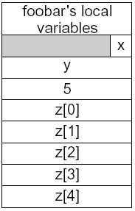

Parameter Specification and Stub Generation
the caller and the callee need to use the same protocol (format of messages) and the same steps; with such rules the client and server stubs can assemble, communicate, and interpret messages correctly
consider the following example; the procedure foobar has 3 parameters: a character, a floating point number, and an array of 5 integers
assume a word is 4 bytes
one possibility is to transmit the character in the rightmost byte, a float as a whole word, and an array as a group of words equal to the array length preceded by a word giving the length
this way both client stub and server stub can understand outgoing and incoming messages
the corresponding message

Slide 31
other issues that need the agreement of the client and the server
how are simple data structures like integers (e.g. 2’s complement), characters (e.g. 16-bit Unicode), Booleans, ... represented?
endianess
which transport protocol to use - the connection-oriented TCP or the unreliable connectionless UDP

Slide 32
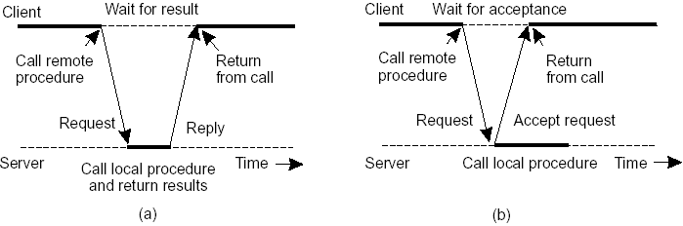
Asynchronous RPC
A shortcoming of the original model: no need of blocking for the client in some cases
two cases
1. if there is no result to be returned
e.g., inserting records in a database, ...
the server immediately sends an ack promising that it will carryout the request
the client can now proceed without blocking
the interconnection between client and server in a traditional RPC
the interaction using asynchronous RPC

Slide 33
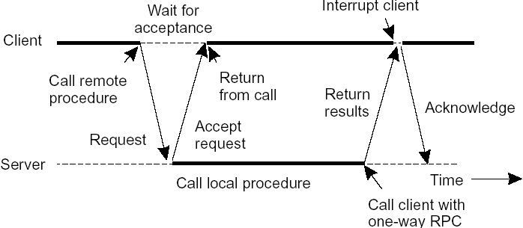
2. if the result can be collected later
e.g., prefetching network addresses of a set of hosts, ...
the server immediately sends an ack promising that it will carryout the request
the client can now proceed without blocking
the server later sends the result
a client and server interacting through two asynchronous RPCs

Slide 34
the above method combines two asynchronous RPCs and is sometimes called deferred synchronous RPC
variants of asynchronous RPC
let the client continue without waiting even for an ack, called one-way RPC
problem: if reliability of communication is not guaranteed

Slide 35
DCE (Distributed Computing Environment) RPC
a middleware and an example RPC system developed by OSF (Open Software Foundation), now The Open Group
it is designed to execute as a layer of abstraction between existing OSs and distributed applications
The Open Group sells the source code and vendors integrate it into their systems
it uses the client-server programming model and communication is by means of RPCs
services
distributed file service: a worldwide file system that provides a transparent way of accessing files
directory service: to keep track of the location of all resources in the system (machines, printers, data, servers, ...); a process can ask for a resource without knowing its location
security service: for protecting resources; access is only through authorization

Slide 36
distributed time service: to maintain clocks on different machines synchronized
Steps in writing a Client and a Server in DCE RPC
the system consists of languages, libraries, daemons, utility programs, ... for writing clients and servers
IDL (Interface Definition Language) is the interface language - the glue that holds everything together
it contains type definitions, constant declarations and what the procedures do (only their syntax)

Slide 37
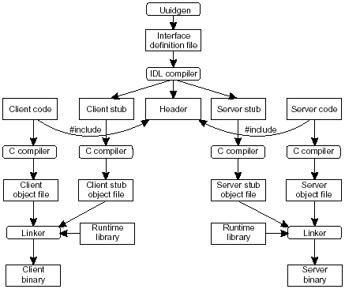
Edit file
Uuidgen generates a prototype IDL file with a globally unique interface identifier
the IDL file is edited (filling the names of procedures and parameters) and the IDL compiler is called to generate 3 files
the application writer writes the client and server codes and are then compiled and linked together with the stubs

Slide 38
Binding a Client to a Server in DCE RPC
for a client to call a server, the server must be registered (1 & 2 in the following figure)
the registration allows the client to locate the server and bind to it
the DCE daemon maintains a table (server, endpoint) and the protocols the server uses
the directory server maintains the locations of all resources in the system (machines, servers, data,, ...)
two steps for server location
locate the server’s machine (3)
locate the server process on that machine (which has what is called an endpoint or port) (4)

Slide 39
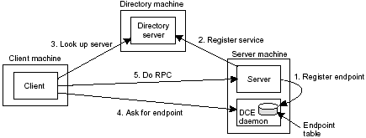

Slide 40
Message-Oriented Communication
RPCs are not adequate for all distributed system applications
the provision of access transparency may be good but they have semantics that is not adequate for all applications
example problems
they assume that the receiving side is running at the time of communication
a client is blocked until its request has been processed

Slide 41
Stream-Oriented Communication
until now, we focused on exchanging independent and complete units of information
time has no effect on correctness; a system can be slow or fast
however, there are communications where time has a critical role
Multimedia
media
storage, transmission, interchange, presentation, representation and perception of different data types:
text, graphics, images, voice, audio, video, animation, ...
movie: video + audio + …
multimedia: handling of a variety of representation media
end user pull
information overload and starvation
technology push
emerging technology to integrate media

Slide 42
The Challenge
new applications
multimedia will be pervasive in few years (as graphics)
storage and transmission
e.g., 2 hours uncompressed HDTV (1920×1080) movie: 1.12 TB (1920×1080x3x25x60x60x2)
videos are extremely large, even after compressed (actually encoded)
continuous delivery
e.g., 30 frames/s (NTSC), 25 frames/s (PAL) for video
guaranteed Quality of Service
admission control
search
can we look at 100… videos to find the proper one?

Slide 43
Multicast Communication
multicasting: delivery of data from one host to many destinations; for instance for multimedia applications
a one-to-many relationship
1. Application-Level Multicasting
nodes are organized into an overlay network and information is disseminated to its members (routers are not involved as in network-level routing)
how to construct the overlay network
nodes organize themselves as a tree with a unique path between two pairs of nodes or
nodes organize into a mesh network and there will be multiple paths between two nodes; adv: robust
2. Gossip-Based Data Transmission
use epidemic protocols where information is propagated among a collection of nodes without a coordinator

Slide 44
Questions

